Slide 1
Marketing Analytics
Session 5
Scoring (basic)

Slide 2
Agenda
Assignment #1
Feedback
Presentation
Predictive modeling
Introduction
Calibration
Logistic regression (logit)
Linear regression
Scoring

Slide 3
Predictive modeling
Introduction to

Slide 4
Predictive modeling
Predictive modeling is one of the most fundamental tools of a marketing analyst
What can be predicted?
Discrete choice (buy or not, die or not, etc.)  %
Multinomial discrete choice (brand choice)  % % %
Continuous (e.g., amount)  $
Discrete-continuous (decision, then amount)  % $

Slide 5
Some vocabulary
Target variable (or dependent variable)
What we try to predict
Predictors (or independent variables)
Demographics
Attitudes, perceptions
Market conditions (price, promotion, etc.)
Past behavior, pattern of previous choices
Etc.
The predictive model will link the two
The model predicts the target variable…
…And in the process, reveals importance weights of predictors (some might have small/zero weight, hence being bad predictors)

Slide 6
Models
Discrete choice
Logit / Probit
Multinomial discrete choice (brand choice)
Multinomial logit / Multinomial probit
Continuous
Linear and nonlinear regression
Discrete-continuous
Tobit II model
Logit + Linear regression

Slide 7
CALIBRATION
Common pitfalls in scoring models

Slide 8
Calibration
Phase #1 – Calibration
You calibrate the model on a dataset where both the predictors and the target variable are observed
Phase #2 – Application, deployment, predictions
You apply the model to a new dataset where only the predictors are known, and the target variable is not

Slide 9
Academic case
PREDICTORS
CUSTOMERS
?
TIME

Slide 10
Data imputation (e.g., satisfaction survey)
PREDICTORS
CUSTOMERS
?
TIME

Slide 11
Moving window (e.g., econometrics)
PREDICTORS
?
CUSTOMERS
TIME

Slide 12
Most realistic case
PREDICTORS
LOST CUSTOMERS
?
CUSTOMERS
OLD CUSTOMERS
NEW CUSTOMERS
TIME

Slide 13
Nasty cases
Errors in predictor selection
SELECT COUNT(*) FROM acts
Predictors without time-stamp
SELECT active FROM contacts

Slide 14
Logit model
Predicting a discrete outcome

Slide 15
Logit model
2 alternatives:
Do not buy Utility of 0 (by convention)
Buy Utility revealed by predictors
The likelihood of buying is a function of how the utility of buying compares to the utility of not buying

Slide 16
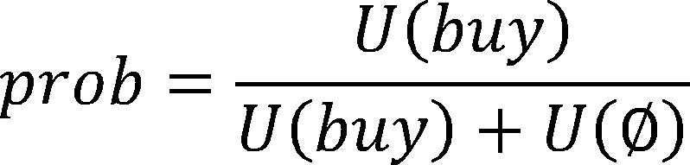
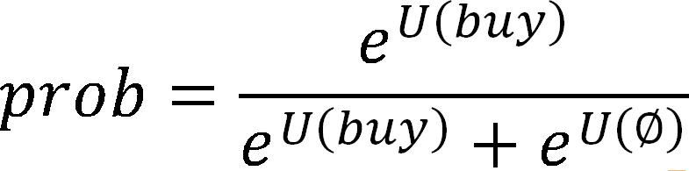
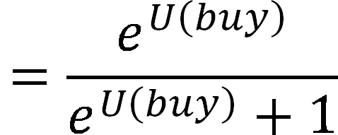
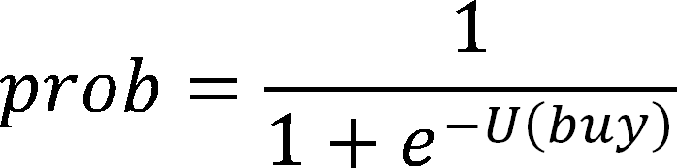
Logit model

Slide 17
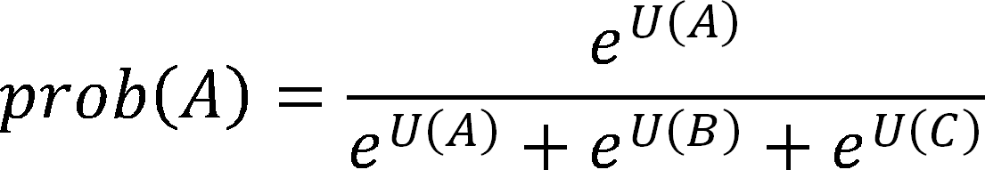
Logit model
The simple model (buy/don't buy):
…is a special case of the multinomial case (e.g., A/B/C):
Can be expanded to A/B/C/∅

Slide 18
Logit model
In the logit model, the "utility" of an alternative is modeled as a linear regression of its predictors
ß₀ is called an "intercept"
The larger/more significant a parameter, the more its predictor influences the target variable

Slide 19

Do we care about p-values?
If the p-value is too large, the parameter is not significant, you should remove it from the model
We often test whether a parameter estimate is different from zero
Essential in hypothesis testing, theory development, etc.
Remember what p=0.4 means !!!
Not critical in predictive modeling

Slide 20
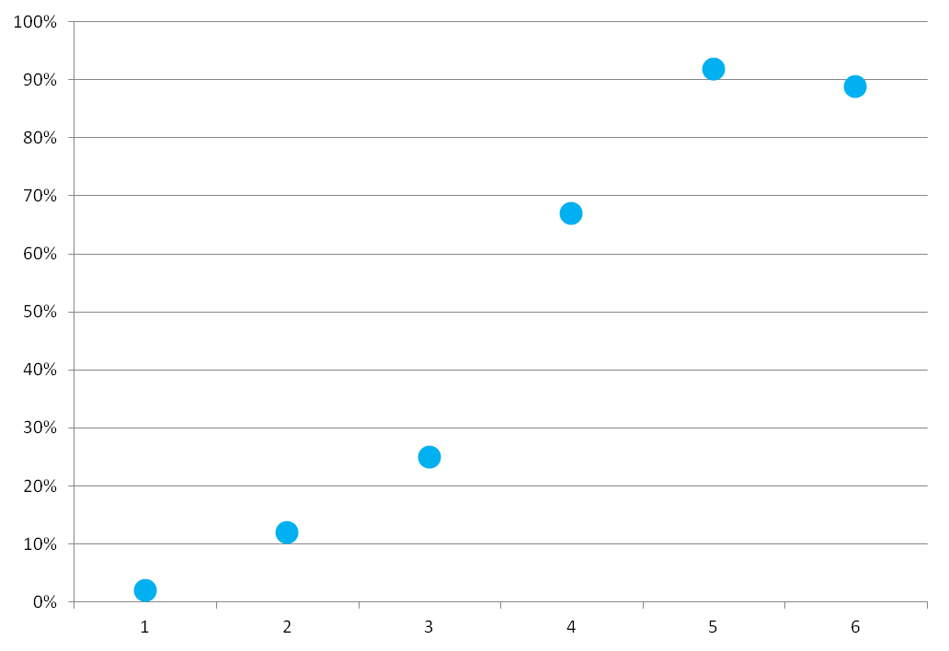
Example

Slide 21
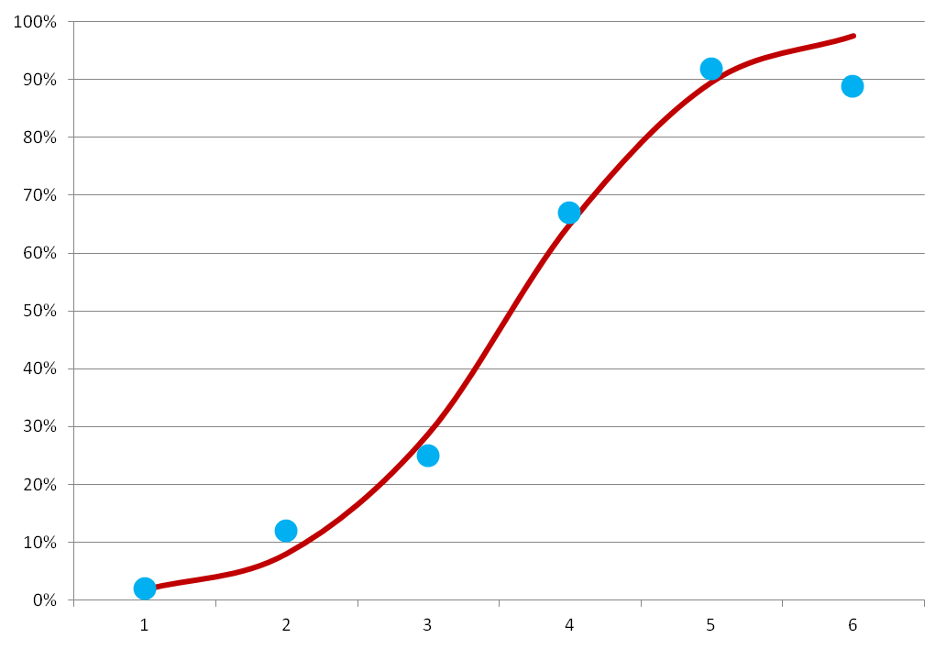
Example

Slide 22
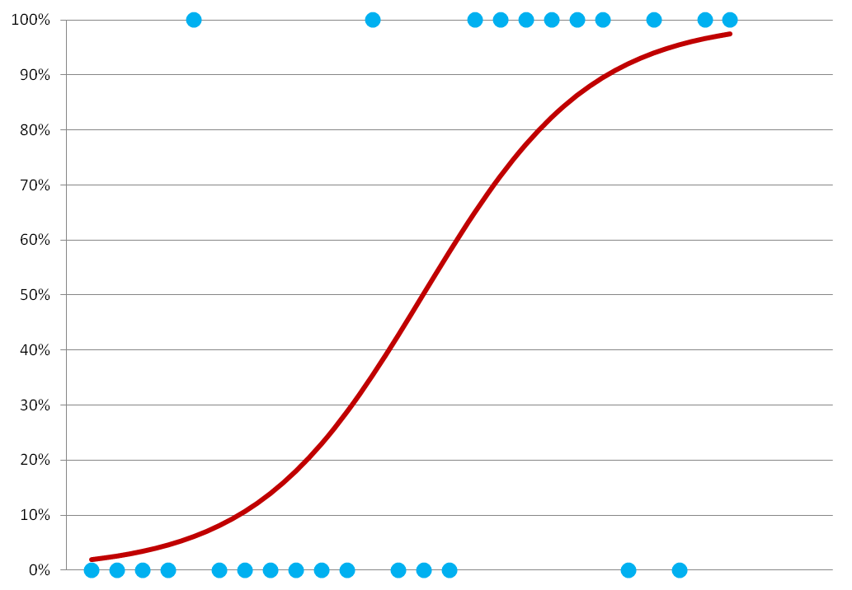
Example (binary choices)

Slide 23
Logit model
# Load the package
library(RODBC)
# Connect to MySQL (my credentials are mysqlodbc/root/root)
db = odbcConnect("mysqlodbc", uid="root", pwd="")
sqlQuery(db, "USE ma_charity")
# Extract data from database
query = "SELECT a.contact_id,
DATEDIFF(20210530, MAX(a.act_date)) / 365 AS 'recency',
COUNT(a.amount) AS 'frequency',
AVG(a.amount) AS 'avgamount',
DATEDIFF(20210530, MIN(a.act_date)) / 365 AS 'firstdonation',
IF(c.counter IS NULL, 0, 1) AS 'loyal'
FROM acts a
LEFT JOIN (SELECT contact_id, COUNT(amount) AS counter
FROM Acts
WHERE (act_date >= 20210530) AND
(act_date < 20220530) AND
(act_type_id = 'DO')
GROUP BY contact_id) AS c
ON c.id = a.contact_id
WHERE (act_type_id = 'DO') AND (act_date < 20210530)
GROUP BY 1"
data = sqlQuery(db, query)
# Close the connection
odbcClose(db)
# Assign contact id as row names, remove id from data
rownames(data) = data$contact_id
data = data[, -1]

Slide 24
Logit model
# One of the libraries available for (multinomial) logit model
library(nnet)
# Logit model
model = multinom(formula = loyal ~ ., data = data)
# Get coefficients, standard errors
coeff = t(summary(model)$coefficients)
stder = t(summary(model)$standard.errors)
zvalues = coeff / stder
pvalues = (1 - pnorm(abs(zvalues), 0, 1)) * 2
# Print results
print("coefficients:")
print(coeff)
print("standard deviations:")
print(stder)
print("p-values")
print(pvalues)

Slide 25
Transforming data
Garbage in, garbage out…
Sometimes, U(x) is not (only) a linear function of X
Logarithm transform?
Square root?
Power transform?
Interaction terms?
Etc.

Slide 26
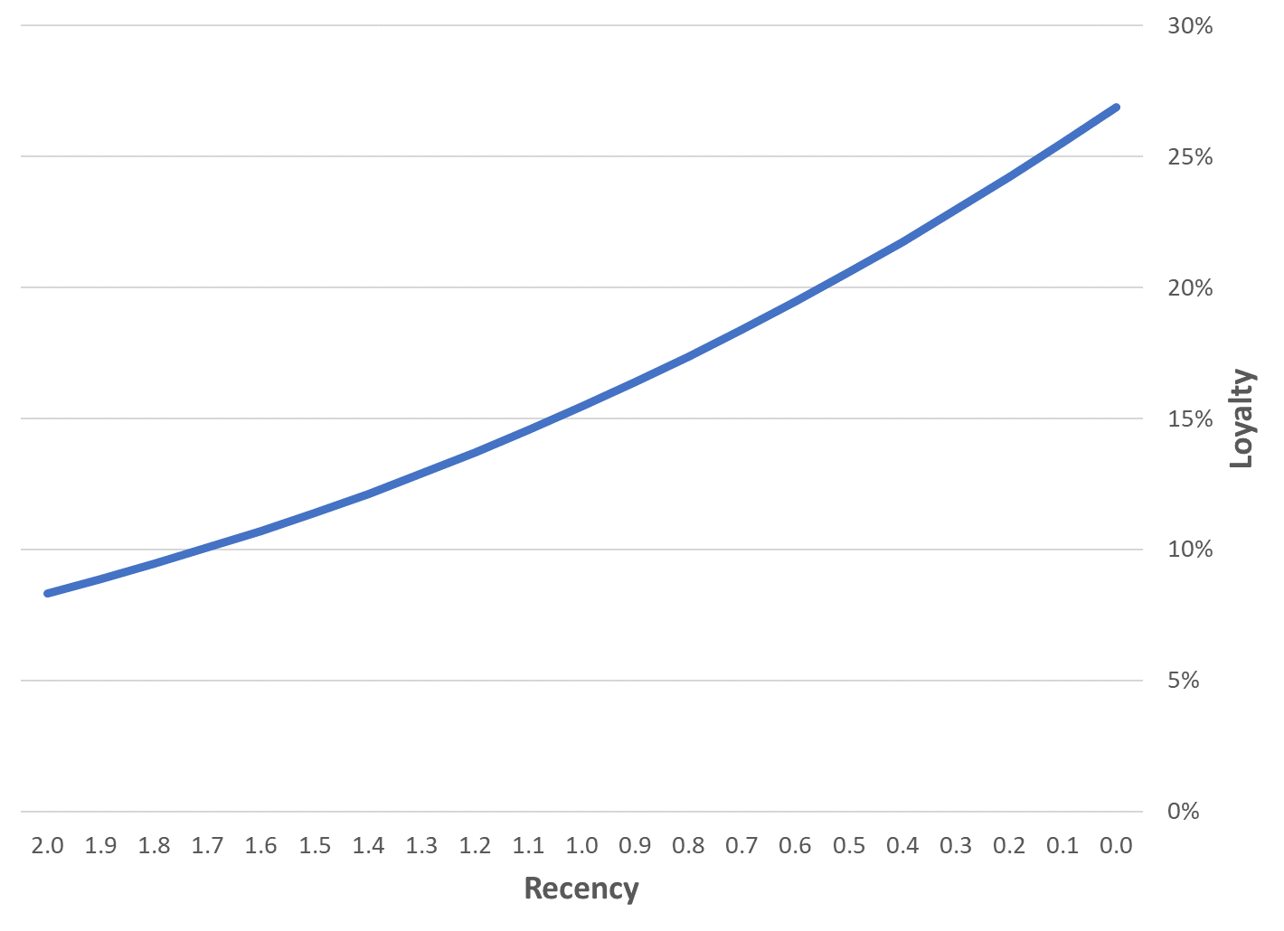
Recency

Slide 27
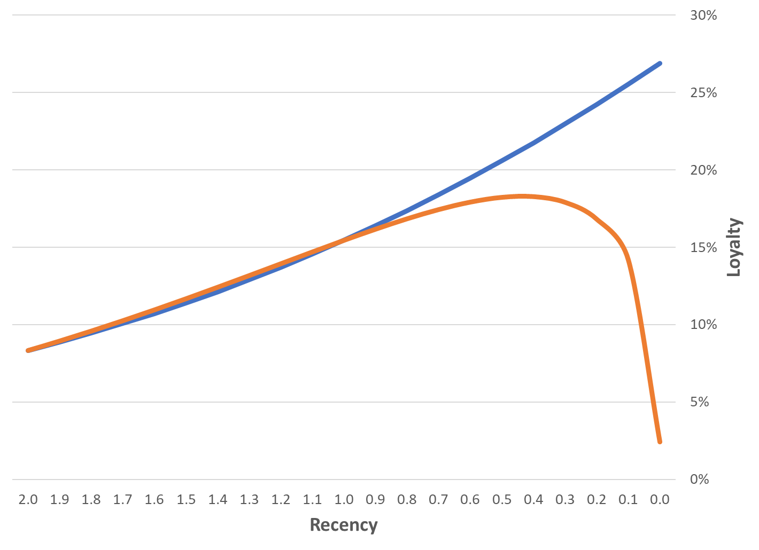
Recency, log(Recency)

Slide 28
Can we really do that?
In the domain [0.1, 2], X and log(X) have a correlation of .93. You can’t introduce correlated predictors in a model !!!
Well… we have to!

Slide 29
Frequency vs. log(Frequency)
If you use frequency, each additional purchase is expected to carry the same information value
Is it true?
From nothing to 1st purchase?
From 1st to 2nd purchase?
From 30th to 31st purchase?
If you use log(frequency), each additional purchase adds less and less value…

Slide 30
Interaction terms
Compare these two individuals
Same seniority
Same recency
Second individual has higher frequency
Who is more likely to give again?
TODAY

Slide 31

Feature engineering
“
Feature engineering is the process of using domain knowledge of the data to create predictors/ features that make machine learning algorithms work

Slide 32
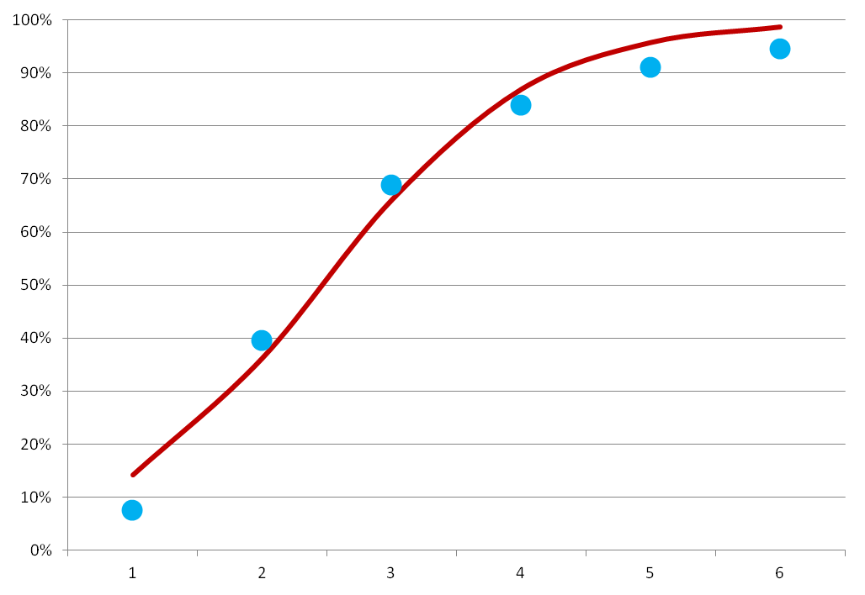
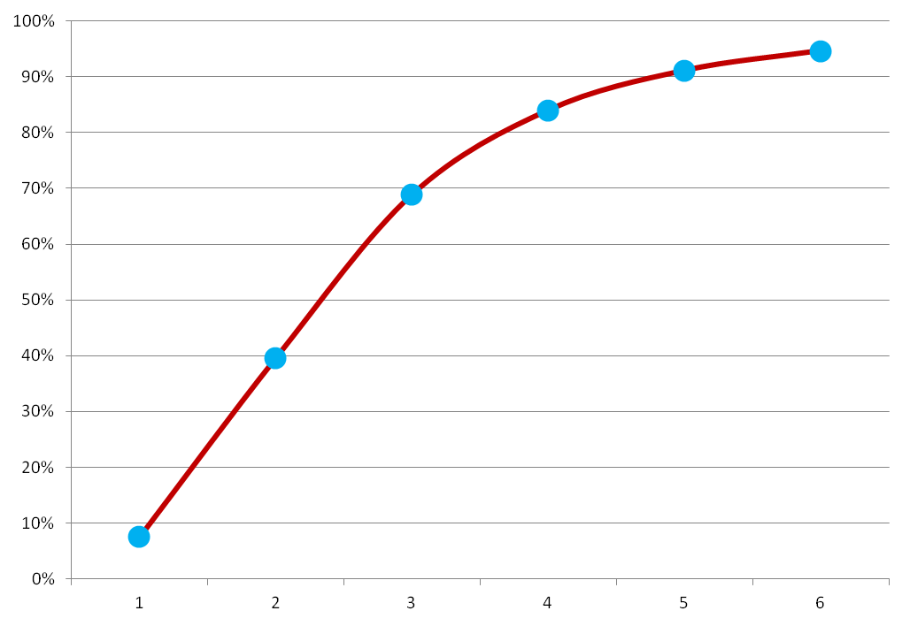
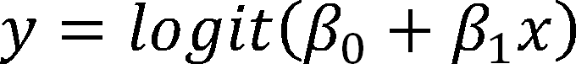
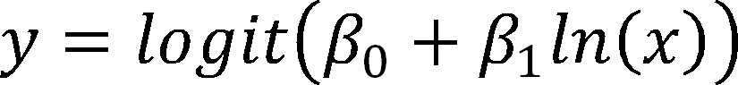
Transforming data

Slide 33
Logit model
# Replace "formula = loyal ~ ." by:
model = multinom(formula = loyal ~ (recency * frequency) + log(recency) + log(frequency), data = data)

Slide 34
Transforming data
What about adding as many terms as possible?
Pros:
Additional terms will always improve predictions
Might capture complex nonlinear/interaction patterns
Cons:
Multicollinearity
Terms are correlated, and causality is harder to determine
 increases variance
 decreases statistical significance
 model becomes less stable (overfitting, out-of-sample)

Slide 35
The simple solution to multicollinearity
If two predictors are highly correlated, you should remove one of them, because it does not add information
Well… it does not add a lot of information
But when you’ll have 250 predictors, “not a lot” times 250 will be a huge deal!

Slide 36
What solutions?
Diagnostic tools
In-sample diagnostic, penalized measures of model fit
AIC
BIC
Out-of-sample diagnostic
Cross-validation and validation sample
Multifold cross-validation (next week)
Jackniffing
Model twists
Stepwise regression
Penalized regression, great against multicollinearity issues
Lasso, Ridge regression

Slide 37
Linear Regression
Predicting a continuous outcome

Slide 38
Linear regression
# Load the package
library(RODBC)
# Connect to MySQL (my credentials are mysqlodbc/root/root)
db = odbcConnect("mysqlodbc", uid="root", pwd="")
sqlQuery(db, "USE ma_charity")
# Extract data from database
query = "SELECT a.contact_id,
AVG(a.amount) AS 'avgamount',
MAX(a.amount) AS 'maxamount',
c.target
FROM acts a
INNER JOIN (SELECT contact_id, AVG(amount) AS target
FROM Acts
WHERE (act_date >= 20210530) AND
(act_date < 20220530) AND
(act_type_id = 'DO')
GROUP BY contact_id) AS c
ON c.id = a.contact_id
WHERE (act_type_id = 'DO') AND (act_date < 20210530)
GROUP BY 1"
data = sqlQuery(db, query)
# Close the connection
odbcClose(db)

Slide 39
Linear regression
# Plot the data
plot(x = data$avgamount, y = data$target)
# Simple linear regression
model = lm(formula = target ~ avgamount + maxamount, data = data)
# Print model results
print(summary(model))

Slide 40
Results
Great fit, huge problems
Problem #1
Disproportionate influence of outliers
Error amplitude is not relative to actual amount
Problem #2
Model can predict negative values !

Slide 41
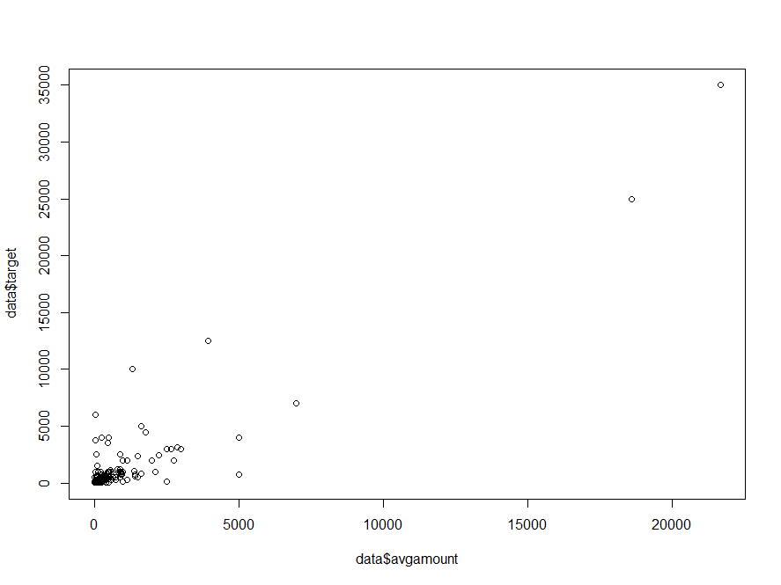
Plot

Slide 42
Log-log model
# Plot the data
plot(x = log(data$avgamount), y = log(data$target))
# Simple linear regression
model = lm(formula = log(target) ~ log(avgamount) + log(maxamount), data = data)
# Print model results
print(summary(model))

Slide 43
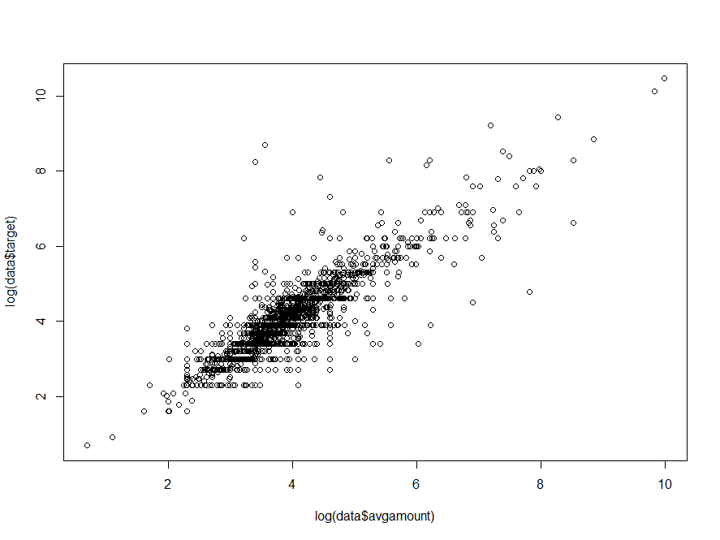
Plot

Slide 44
Scoring
Putting it all together…

Slide 45
Score
A score is the characterization of a customer’s most likely behavior or potential
Notes:
Example: a geographic map is a model. A model is designed for a specific purpose.
e.g. a map to navigate does not include all details of the environment (houses etc), but only roads, highway numbers and distances

Slide 46
Score
In the most simple case, a score is simply the result of a choice model (e.g., likelihood of purchase).
In more complex cases, a score can be the result of a combination of choice and predictive models
Notes:
Example: a geographic map is a model. A model is designed for a specific purpose.
e.g. a map to navigate does not include all details of the environment (houses etc), but only roads, highway numbers and distances

Slide 47
Example of score
Fundraising context:
Likelihood of donation (choice model)
Predicted donation amount in case of donation (e.g., regression analysis)
Score = combination of both (expected donation amount)
Two donors can have similar scores with different underlying behavior (*)

Slide 48
Score class
A score class is a grouping of customers whose scores fall within a given range

Slide 49
Example of score classes
Donors are grouped into 4 classes: A, B, C, D
A
B
C
D

Slide 50
Complete scoring model
# Load the package
library(RODBC)
# Connect to MySQL (my credentials are mysqlodbc/root/root)
db = odbcConnect("mysqlodbc", uid="root", pwd="")
sqlQuery(db, "USE ma_charity")
# Extract calibration data from database
query = "SELECT a.contact_id,
DATEDIFF(20210530, MAX(a.act_date)) / 365 AS 'recency',
COUNT(a.amount) AS 'frequency',
AVG(a.amount) AS 'avgamount',
MAX(a.amount) AS 'maxamount',
IF(c.counter IS NULL, 0, 1) AS 'loyal',
c.targetamount AS 'targetamount'
FROM acts a
LEFT JOIN (SELECT contact_id, COUNT(amount) AS counter, AVG(amount) AS targetamount
FROM Acts
WHERE (act_date >= 20210530) AND
(act_date < 20220530) AND
(act_type_id = 'DO')
GROUP BY contact_id) AS c
ON c.id = a.contact_id
WHERE (act_type_id = 'DO') AND (act_date < 20210530)
GROUP BY 1"
data = sqlQuery(db, query)

Slide 51
Complete scoring model
# Show data
print(head(data))
# In-sample, probability model
library(nnet)
prob.model = multinom(formula = loyal ~ (recency * frequency) + log(recency) + log(frequency), data=data)
# In-sample, donation amount model
# The amount model only applies to a subset of donors...
z = which(!is.na(data$targetamount))
print(head(data[z, ]))
amount.model = lm(formula = log(targetamount) ~ log(avgamount) + log(maxamount), data = data[z, ])

Slide 52
Complete scoring model
# Extract prediction data from database
query = "SELECT contact_id,
DATEDIFF(20220530, MAX(act_date))
/ 365 AS 'recency',
COUNT(amount) AS 'frequency',
AVG(amount) AS 'avgamount',
MAX(amount) AS 'maxamount'
FROM acts
WHERE (act_type_id = 'DO')
GROUP BY 1"
newdata = sqlQuery(db, query)
print(head(newdata))
# Close the connection
odbcClose(db)

Slide 53
Complete scoring model
# Out-of-sample predictions. Do NOT forget
# to re-transform "log(amount)" into "amount"
out = data.frame(contactid = newdata$contact_id)
out$probs = predict(object = prob.model,
newdata = newdata,
type = "probs")
out$amount = exp(predict(object = amount.model,
newdata = newdata))
out$score = out$probs * out$amount
# Show results
print(head(out))
# Who is likely to be worth more than 5 EUR?
z = which(out$score > 5)
print(length(z))

Slide 54
That’s all folks !

